Slide 1
StoryToGame: Game Level Generator from Narrative Input
by
Jabez John A

Slide 2
Abstract
This project, StoryToGame: A Story-Based Game Generator, aims to automatically transform user-written narratives into playable 2D games. The system accepts natural language stories as input and, using a combination of machine learning and rule-based classification, identifies whether the game should be a Knight Adventure or a Space Shooter. Once classified, relevant game assets such as backgrounds, characters, enemies, and sound effects are mapped to the story context. Levels are then dynamically generated in Pygame, featuring animations, enemy behaviors, and progression challenges.
The project demonstrates an end-to-end workflow that integrates Natural Language Processing (NLP), asset mapping, and 2D game development. It provides an innovative framework for automating creative game design and showcases the potential of combining artificial intelligence with interactive entertainment.

Slide 3
Introduction
Game development traditionally requires significant manual effort in designing levels, characters, and environments. This limits rapid prototyping and creativity for users who are not skilled in game design. On the other hand, storytelling is one of the most natural ways for people to express imagination.
The project StoryToGame: A Story-Based Game Generator bridges this gap by allowing users to provide a simple written story, which is then automatically converted into a playable 2D game. Using a combination of machine learning for story classification and Pygame for game generation, the system supports two genres: a Knight Adventure and a Space Shooter. Each genre features multiple levels, unique enemies, character animations, and sound effects, creating an engaging game experience from plain text input.
problem
  Game design is time-consuming.
  Manual level creation limits creativity.
solution
  Goal: Convert written stories into playable 2D games
  Scope: End-to-end pipeline from story input to game output
  Two genres supported: Knight Adventure & Space Shooter
  Features: Levels, enemies, animations, and sounds
  Audience: Creative users, designers, and educators

Slide 4
Objectives
The main objectives of the StoryToGame project are:
  To develop an AI-driven system that converts narrative text into a playable 2D game.
  To classify user stories into specific genres (Knight Adventure or Space Shooter) using ML and keyword-based methods.
  To design automated level generation with enemies, backgrounds, and progression based on the story.
  To implement character animations, enemy AI, and sound effects for an engaging experience.
  To create a user-friendly interface for story input and game generation.

Slide 5
System Workflow
  User Input
  "User story (Tkinter text box)"
  text or keyboard
5. Level & Enemy Generator
2. Preprocessing
  Generate levels, place enemies, set waves/difficulty
  "Text cleaning & TF-IDF vectorization"
  "tokenize, lowercase, remove stopwords"
6. Pygame Engine (Runtime)
3. Classifier / Keyword Rules
  Render scenes, handle input, run physics & collisions, play SFX"
  "ML model → Genre?"
  Space and Knight
  fallback to keyword rules if model confidence low
7. Output / Gameplay
  "Playable game levels — user plays and advances"
4. Asset Mapping
  Knight branch: "Map to knight sprites, tiles, sounds"
  Space branch: "Map to space sprites, background, SFX"

Slide 6
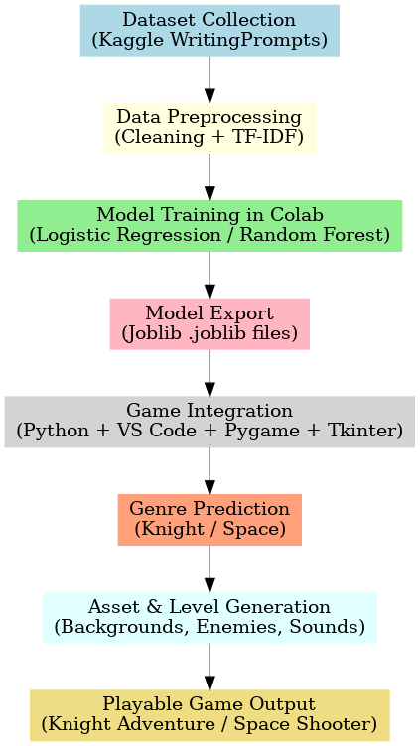
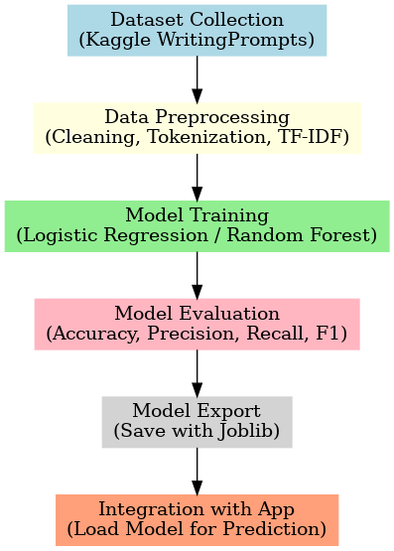
ML Workflow
System Workflow
(Process)

Slide 7
Tools and Technologies
  Programming Language:
    Python – chosen for its simplicity and extensive library support in both ML and game development.
  Libraries & Frameworks:
    Pygame – for building the 2D game engine, animations, collision detection, and rendering.
    Scikit-learn – for training and deploying the machine learning model used in story classification.
    Joblib – for model persistence (saving/loading trained ML models).
    Tkinter – for building a simple GUI window to collect user story input.
  Datasets:
    WritingPrompts (Kaggle) – narrative text dataset used for training story classification.
  Assets:
    Sprites, tilesets, and sound effects (sourced from Craftpix, Pixabay, Mixkit, and other free resources).
  Development Environment:
    Visual Studio Code (VS Code) – code editing and debugging.
    Google Colab – used for ML model training and experimentation.
    Git / GitHub – for version control and backup.

Slide 8
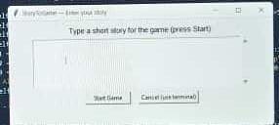
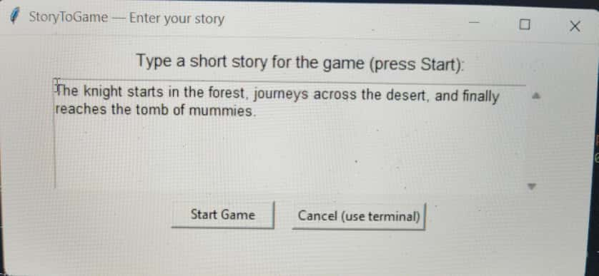
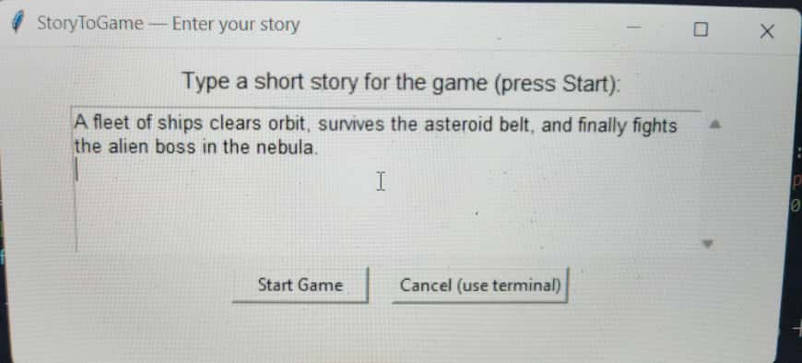
Inputs

Slide 9
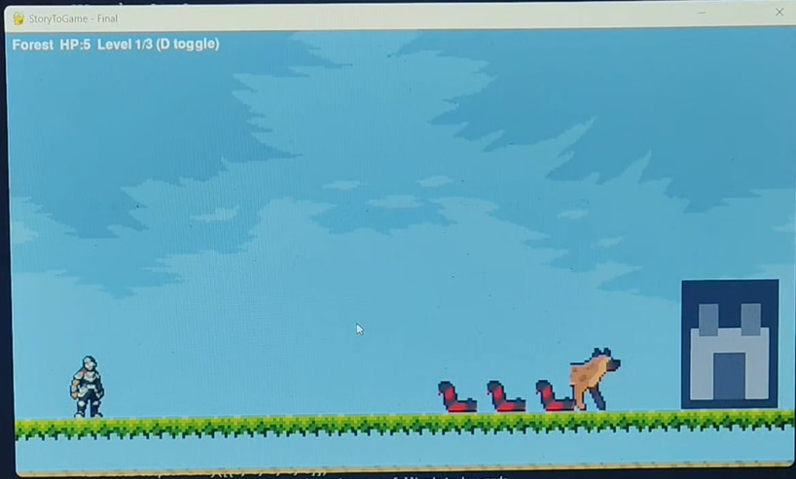
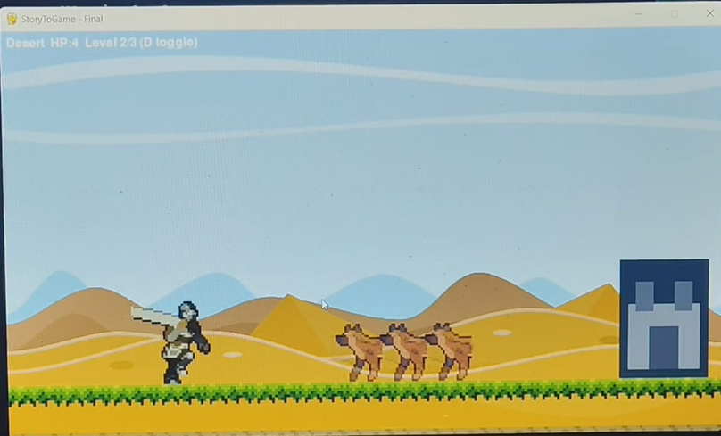
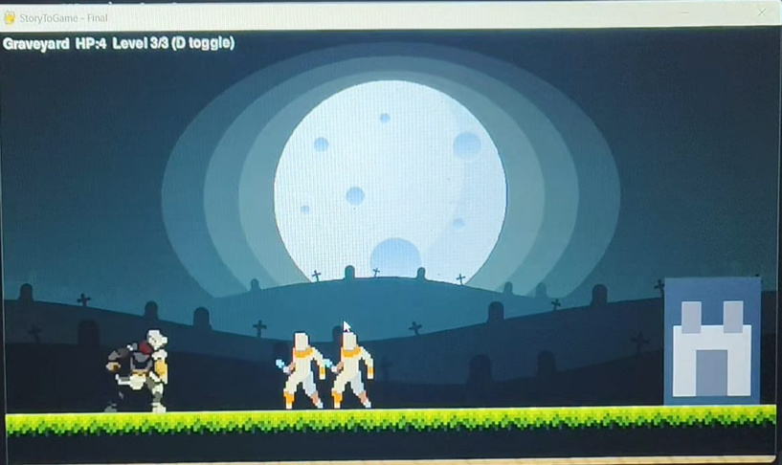
Knight Adventure
Levels: Forest , Desert , Graveyard
Enemies: Snake , Hyena , Mummy
Features: Attacck , Jump , Castle goal

Slide 10
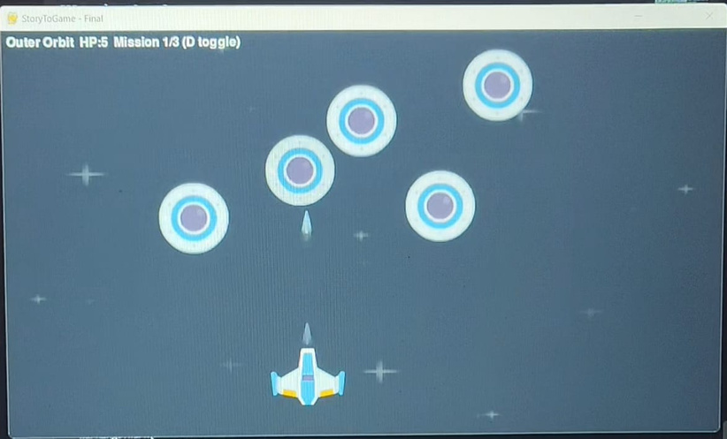
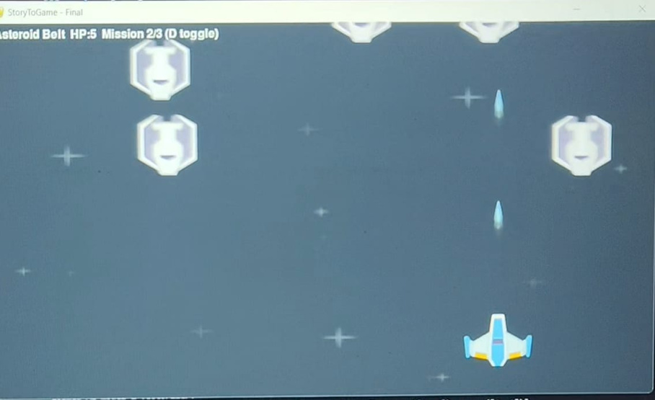
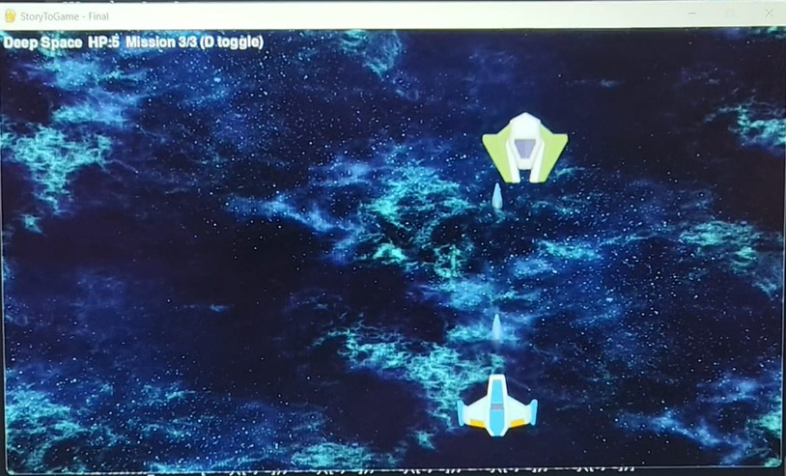
Space Shooter
Levels: Outer orbit , Asteroid Belt , Deep Space
Enemies: Alien , Drone , Boss
Features: Continuous shooting , Enemy waves , Boss battle

Slide 11
Result
  Successfully converts stories into 2D games
  Two genres: Knight Adventure & Space Shooter
  Multi-level progression with unique enemies
  Integrated animations & sound effects
  Smooth gameplay with user story input

Slide 12
Challenges
  Dataset complexity and story variability
  Handling inconsistent sprite sizes & animations
  ML classification accuracy for mixed words
  Integrating ML pipeline with Pygame
  Performance optimization for smooth gamepla
Future Scope
  Add more game genres (RPG, Racing, Puzzle)
  Use advanced NLP (BERT/transformers) for deeper story understanding
  Procedural map and level generation
  Multiplayer or co-op modes
  Deploy as a web/cloud-based platform

Slide 13
Conclusion
  Project achieved story-to-game conversion
  Two genres supported: Knight & Space
  Multi-level gameplay with enemies, animations, and sound
  ML + Pygame integration worked effectively
  Foundation for future AI-driven game generation

Slide 14
Thank you

